Slide 1

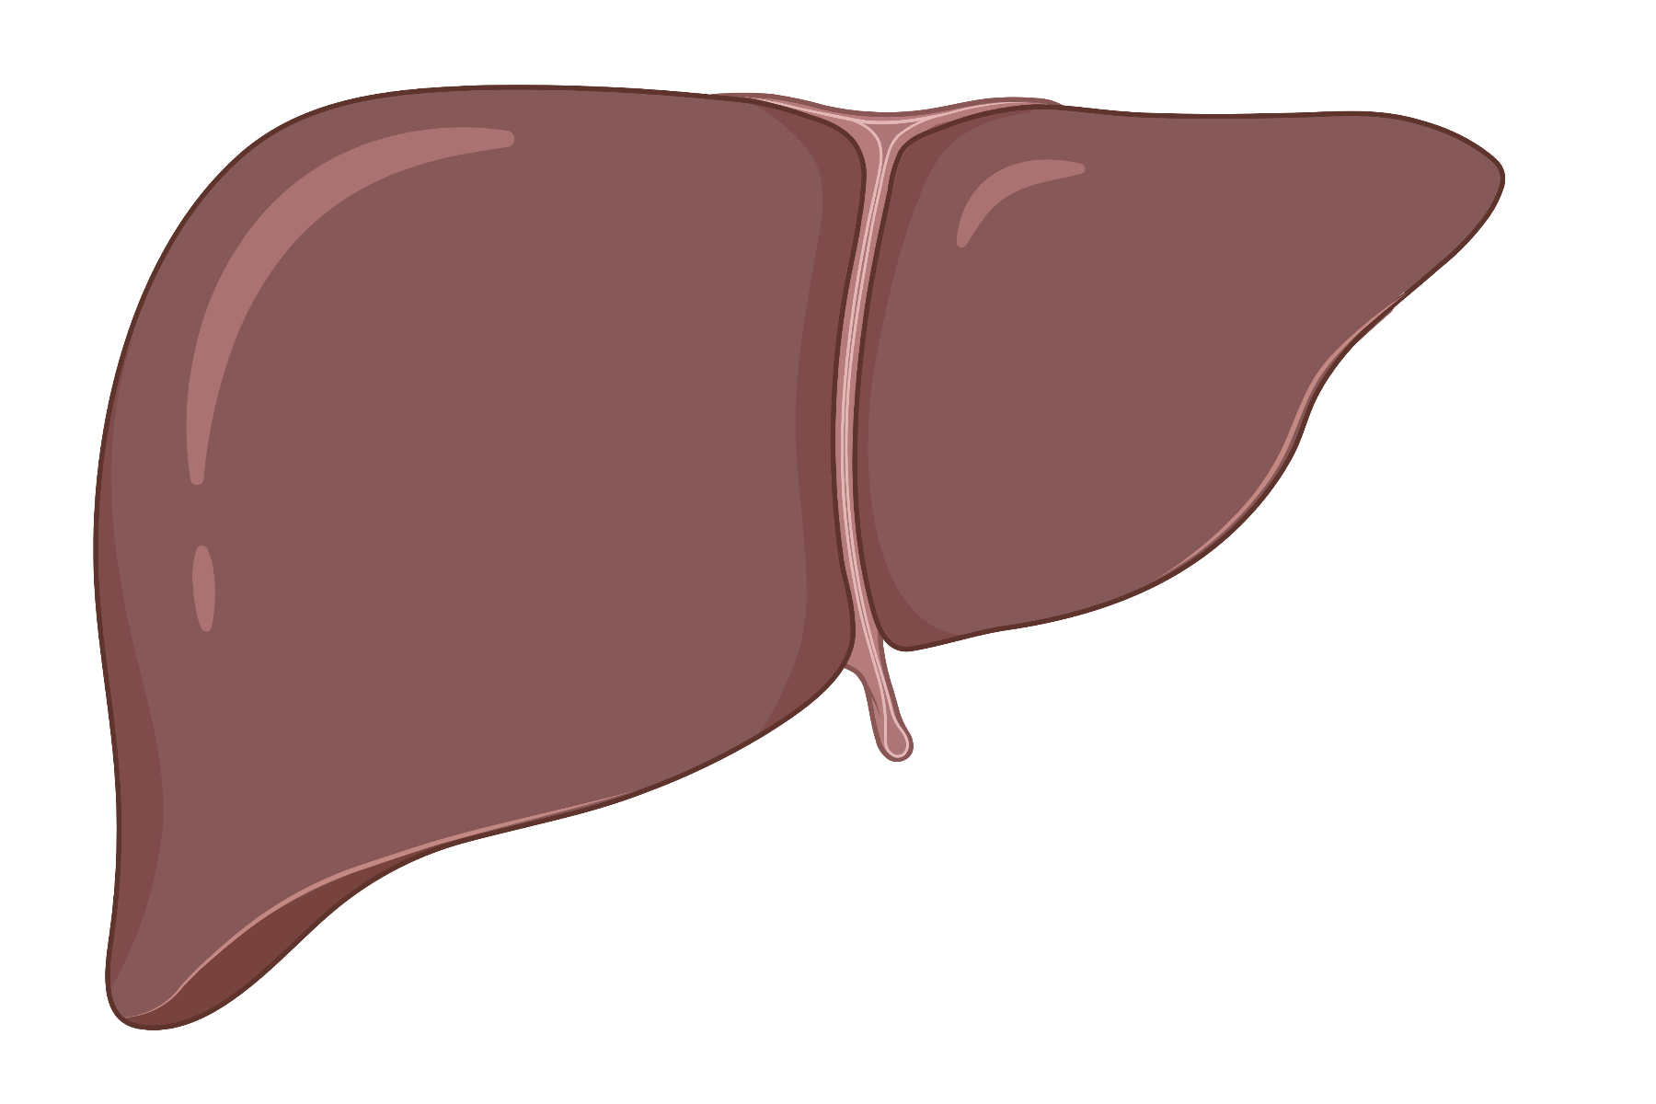
Definition
Use the table of contents to navigate
Acute Liver Failure
Etiologies
Management
Cases

Slide 2

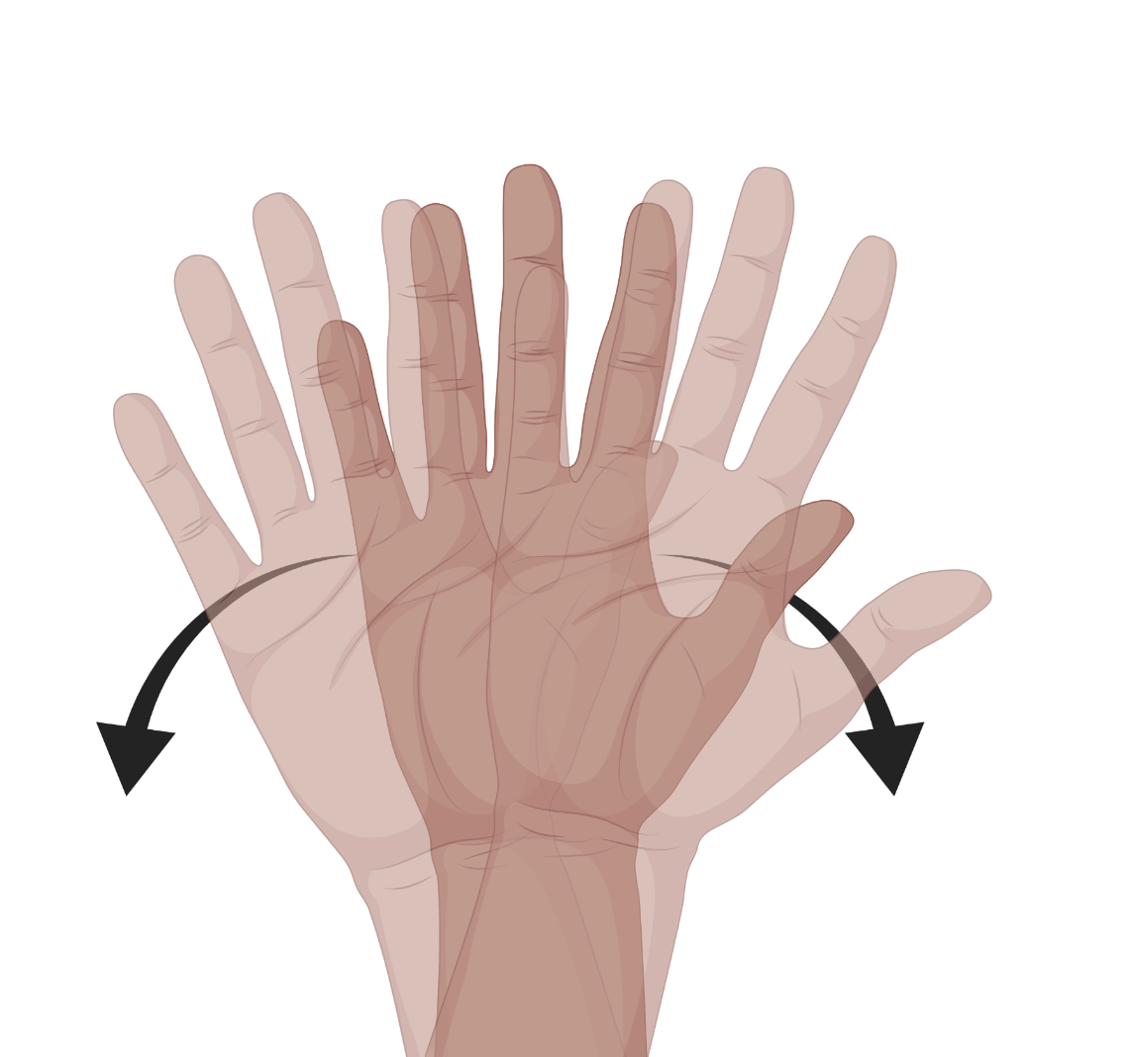

Definition
DEFINITION AND CRITERIA FOR ALF
Etiologies
Must meet all three criteria
Management
1
Fulminant
Acute
Subacute
1
Acute Liver Inflammation
Onset < 26 weeks
↑AST, ALT, and bilirubin
No chronic liver disease (exception HBV, AIH, & Wilson’s)
Cases
1 wk
3 wk
26 wk
2
2
Coagulopathy (INR >1.5)
Marker of liver synthetic dysfunction
3
Severity corresponds with risk of cerebral edema. ​
3
Hepatic Encephalopathy
I
II
III
IV
Altered sleep/wake
Asterixis Lethargy
Severe lethargy
Coma
z
z
z

Slide 3
Definition
ETIOLOGIES AND EVALUATION
Etiologies
ETIOLOGIES
WORK-UP
Management
Drugs/Toxins
Drugs/Toxins
Viral
Other
Ischemia
Acetaminophen
Statins, AEDs, antibiotics
Supplements
Mushrooms (e.g., Amanita)
APAP, salicylate level
Toxicology screen
Review NIH LiverTox
Cases
Click to reveal differential. Then click again to reveal work-up
Viral
Hepatitis A, B, D, & E
Rarely: HSV, VZV
Viral hepatitis serologies & PCRs
HIV
Ischemia
Budd-Chiari
Shock liver / Ischemic hepatitis
Liver US with doppler
Other
Autoimmune Hepatitis
Pregnancy-related (ie. HELLP, AFLP)
Wilson's Disease
ANA, anti-smooth muscle Ab, IgG
Pregnancy test
Ceruloplasmin, 24 hr Cu
Liver biopsy

Slide 4
Definition
MANAGEMENT OF ALF
1
CT head, ICP monitoring
Intubation (airway protection)
↑HOB, Hypertonics
Etiologies
Address
Complications
Arterial ammonia > 150
Address
Complications
Cerebral Edema
Cerebral Edema
Management
Hypoglycemia
BG q1-2 hours
Continuous dextrose infusion
Hypoglycemia
Cases
Multiorgan Failure
ICU monitoring, q4-6 hour labs
Intubation, vasopressors, RRT if needed
Multiorgan Failure
Coagulopathy
Reversal only if bleeding
Coagulopathy
Infection
± prophylactic/empiric antibiotics, antivirals
Infection
2
Give NAC
Give NAC
NAC improves liver transplant-free survival (even in non-APAP induced ALF)
Use King’s College Criteria (±MELD) to identify patients unlikely to recover spontaneously and more likely to benefit from a liver transplant
3
Prognosticate
Prognosticate
Bonus: Learn more about KCC
4
Transfer
Transfer
Liver transplant centers allow for early transplant listing

Slide 5
Definition
PROGNOSTICATION IN ALF (KING’S COLLEGE CRITERIA)
Etiologies
What is KCC?
Criteria developed to identify patients with ALF who are unlikely to recover spontaneously
What is KCC?
Management
When to use KCC
Cases
When to use KCC
In APAP or non-APAP ALF to determine likelihood of requiring liver transplant.
How to interpret?
King’s College Criteria
APAP toxicity | Non-APAP ALF
pH < 7.3 | INR > 6.5 (PT > 100)
OR all of the below: | OR at least 3 of the following:
INR > 6.5 (PT > 100) | Age < 10 or > 40
Cr > 3.3 mg/dL | HAV, HBV, drug-related ALF
Grade III or IV HE | Jaundice precedes HE by >7 d
 | INR > 3.5 (PT > 50)
 | Tbili > 18 mg/dL
How to interpret?
Meet criteria?
No
Yes
Spontaneous recovery more likely, continue supportive treatment
Consider early transfer to LT center and/or liver transplant
MELD
end organ damage (↑ lactate, phosphate, Cr, Tbili)
synthetic dysfunction (INR is most important prognostic marker!)
Other markers of poor prognosis
Other markers of poor prognosis

Slide 6
Definition
Case 1
Etiologies
29-year-old with recurrent pancreatitis presents with progressive abdominal pain x 4 d. They take 1000 mg of APAP q4h for pain. Over the past 24h, they developed nausea, vomiting, anorexia, and RUQ pain. Denies fevers, chills, or ill contacts.
Exam: Vital signs stable.
Alert and oriented x 4. No asterixis.
Epigastric and RUQ tenderness to palpation, but otherwise is unremarkable.
Labs: AST 9290, ALT 4550, ALP 118, total bilirubin 2.3, and INR 2.3.
…On HD2, they are confused, oriented to self only. Exam shows asterixis.
Management
What is the diagnosis?
Cases
Acute liver failure
1
2 - 3
Which is NOT part of the work-up for ALF?
4
A) Acetaminophen level
B) Liver US with doppler
C) Viral hepatitis serologies
Ethanol does not cause ALF
What is the diagnosis?
D) Ethanol level
Acute liver injury. Without encephalopathy, they do not meet criteria for ALF.
Which of the following is the best next step in evaluation and management?
Which lab abnormalities represents synthetic dysfunction?
A) Administer NAC
B) Liver US with doppler
NAC improves LT-free survival
Elevated INR
C) Heparin infusion
D) Obtain echocardiogram

Slide 7
Definition
Case 2
Case 3
Etiologies
35-year-old presents with acute liver failure due to fulminant hepatitis B. Initially, they had grade 1 HE. CT head was normal. ​
On HD2, they develop new nausea and vomiting not responsive to antiemetics.
VS: HR 58, BP 160/88, RR 20, SpO2 94% on 2L NC.
Exam: Somnolent but arousable, oriented to self, mild asterixis. No focal neurologic deficits.
Labs: Glucose 180. ABG 7.2/54/80/23. Ammonia 202.
69-year-old with PMH of CHF, HTN, and type II DM is admitted with abdominal pain and fatigue.
VS: 37.5C, HR 145, BP 82/52, T 36.5 °C
Exam: Moderate distress, cold distal extremities with 2+ pitting edema to bilateral knees. Oriented only to self, + asterixis.
Diagnostics:
BMP: Cr 2.4 (baseline 0.9)
ALT 3600, AST 5600, INR 2.2
EKG shows sinus tachycardia. Troponin <0.04, BNP 2400. TTE shows LVEF of 10-20%.
HAV IgM -, HBc IgM -, HBsAg -, HBs Ab +, HCV Ab -
Management
82/52
Cases
1
2 - 3
4
What is the next step in evaluation?
What is the most likely cause of this patient’s elevated LFTs?
Repeat CT head to evaluate for ↑ ICP. Ammonia > 200 predicts intracranial hypertension.
A) Hepatitis C
B) Drug Overdose
C) Autoimmune hepatitis
↓ BPs likely suggest shock liver.
D) Cardiogenic Shock
…CT head shows early cerebral edema without midline shift or herniation.
Which of the following is the most appropriate next step in management?
What is the next step in management?
Empirically treat only if febrile
Reverse INR only if bleeding
B) Acyclovir
Elevate head of bed >30º
Consider direct ICP monitoring
Q1h neuro checks
Hypertonics (hypertonic saline or mannitol)
A) FFP
C) Paracentesis
D) Vasopressors/inotropy
Vasopressors/inotropes

Slide 8
Definition
Case 4
Etiologies
59 year-old with a history of ESRD s/p kidney transplant 5 years ago on chronic immunosuppression presents to a small community hospital with fever, chills, and ALF.
VS: T 38.8°C, HR 98, BP 117/58, RR 18, SpO2 95% on RA.
Exam: Jaundiced, lethargic, mild asterixis.
Labs: WBC 13K, AST 2300, ALT 1960, Tbili 22, INR 4.2, Cr 1.8 (unknown baseline).
APAP level and urine tox is negative.
In addition to starting NAC, which of the following treatments is warranted while waiting for laboratory results?
Management
Cases
Empiric acyclovir given pt febrile until HSV PCR returns
A) Tylenol
B) Acyclovir
1
C) Prednisone
D) Activated Charcoal
2 - 3
What tools can be used to risk-stratify this patient and in what location should this patient be cared for?
4
What online resource can be used to determine if this patient’s could have caused ALF?
King’s College Criteria (or MELD) can help identify patients who are unlikely to spontaneously recover.
This patient meets non-APAP KCC criteria and is high risk for needing a liver transplant. Transfer early to a liver transplant capable center.
King’s College Criteria
Non-APAP toxicity
INR > 6.5 (PT > 100)
OR at least 3 of the following:
Age < 10 or > 40
HAV, HBV, drug-related ALF
Jaundice precedes HE by >7 d
INR > 3.5 (PT > 50)
Tbili > 18 mg/dL
The NIH website, LiverTox, can be used to review liver injury patterns and potential severity for most medications and supplements (livertox.nih.gov)

Slide 9
Acute Liver Failure - Summary
DEFINITION
1)
2)
3)
MANAGEMENT
1)
ETIOLOGIES
Drugs/Toxins
Viral
Other
Ischemia
2)
3)
4)

Slide 10
Acute Liver Failure - Summary
DEFINITION
1) Acute liver inflammation*
2) Coagulopathy (INR > 1.5)
3) Hepatic Encephalopathy
*Without underlying liver disease
MANAGEMENT
1) Treat and prevent complications
Complication | Monitoring/ Treatment
Cerebral Edema | CT head Q1-4h neurochecks Intubation (airway protection) HOB > 30º, hypertonic saline, mannitol
Hypoglycemia | From lack of gluconeogenesis Q1-2h blood glucose D5W infusion
Multiorgan failure | Intubation, vasopressors Renal replacement therapy
Coagulopathy | FFP and IV vitamin K only if bleeding
Infection | Consider prophylactic antibiotics/ antivirals
ETIOLOGIES
Drugs/Toxins
Viral
Other
Ischemia
APAP, statins, AED, abx
Supplements, mushrooms
APAP, salicylate level
Urine tox screen
Hepatitis A, B, D, & E
Rarely: HSV, VZV
Viral serologies and PCRs
HIV
Budd-Chiari
Shock liver / Ischemic hepatitis
Liver ultrasound with doppler
2) NAC
Autoimmune Hepatitis
Pregnancy-related
Wilson’s Disease
ANA, AMSA, IgG
Pregnancy test
Ceruloplasmin
3) Risk calculators (KCC) to prognosticate
4) Transfer to Liver Transplant (LT) Center

Slide 11
Currency Note & Framing Update (2026)
• Standing teaching verified current against AASLD acute liver failure practice guidance. The 3-criteria definition, etiology categories, "NAC for all ALF," King’s College Criteria, and early transfer are unchanged.
• NAC nuance: the transplant-free survival benefit in NON-acetaminophen ALF is greatest in EARLY-stage disease with low-grade (I–II) hepatic encephalopathy; benefit is not established in advanced (grade III–IV) HE (Lee et al., Gastroenterology 2009). Still give NAC empirically to all ALF.
• Cerebral edema risk: arterial ammonia >150–200 µmol/L predicts intracranial hypertension and severe HE — a marker for heightened neuro-monitoring (consistent with the deck’s ammonia >150 / >200 cues).
• Prognostication: MELD is increasingly used alongside (and in some centers instead of) King’s College Criteria; both should be applied with hepatology input. KCC remains specific but not sensitive — do not use a negative KCC to defer transplant-center transfer.
• Acetaminophen remains the single most common cause of ALF in the US/Europe (~50%); alcohol alone does NOT cause ALF.

Slide 12
Take-Home Points
• ALF = acute liver injury (<26 wks, no chronic liver disease*) + coagulopathy (INR >1.5) + hepatic encephalopathy. All three are required; HE is what separates ALF from acute liver INJURY. (*exceptions: HBV, AIH, Wilson’s.)
• Drugs/toxins (esp. acetaminophen) and viral hepatitis account for >50% of cases; also screen for ischemic/vascular, autoimmune, pregnancy-related, and Wilson’s causes. Send the etiology work-up in parallel.
• Manage in the ICU: address complications (cerebral edema, hypoglycemia, multiorgan failure, coagulopathy, infection). Reverse coagulopathy ONLY for active bleeding — INR is a key prognostic marker.
• Start NAC early in all ALF — it improves transplant-free survival even in non-acetaminophen cases (greatest benefit in early/low-grade HE).
• Consider transplant candidacy early and TRANSFER to a liver-transplant center as soon as possible — especially if King’s College Criteria are met — before progression precludes safe transfer.

Slide 13
Attribution, License & Changelog
Adapted from the TeachIM original "Acute Liver Failure" (published April 2022).
• Authors: CJ Mowry, MD; Michael Kriss, MD. Section Editors: Elijah Mun, MD; John Haydek, MD. Executive Editor: Yilin Zhang, MD.
• Source: https://teachim.org/teaching_material/alf/
• License: Creative Commons Attribution-NonCommercial 4.0 International (CC BY-NC 4.0). Non-commercial educational use only.
• Optimization (June 2026): two surgical typo corrections — Case 2 slide "Acyclovir`1q1" → "Acyclovir"; Summary slide "Cerulopasmin" → "Ceruloplasmin". All original click-to-reveal animations and graphics preserved.
• Added: currency-note slide (NAC/HE-grade nuance, ammonia threshold, MELD vs KCC) + take-home slide. Companion files: ALF teaching guide (ALF-Learning-Guide-Final-Draft-4.3.docx), learner worksheet (ALF-learner-worksheet.pdf), completed board (ALF-teacher-worksheet-and-board-set-up.pdf) — reviewed, no changes needed.
Medical content should be clinician-reviewed before teaching.

